Slide 1

ZS DATA SCIENCE OFFLINE DATA-A-THON PRESENTATION
Sateesh Sivakoti
5th Year Dual Degree in Aerospace Engineering
IIT MADRAS

Slide 2
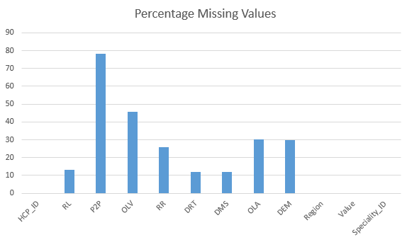
Quality Checks and Pre Processing
Speciality ID is given as a numerical feature.
All the channels have missing data.

Slide 3
P2P has a significant proportion of missing values, so it would not be a good idea to use this channel to predict other channel affinities.
The demographic data set has a few missing values in the gender column.
The ‘Speciality_ID’ feature was converted into categorical data.
The demographic data set was merged on the ‘HCP_ID’ column of the train data.
Region and value features were combined to form one feature.
The age feature was modified to a binary class for certain channels to make better use of the data.

Slide 4
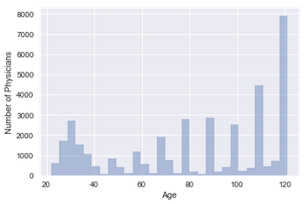
Observations
There was a very high population of physicians above 100 years (~38%).

Slide 5
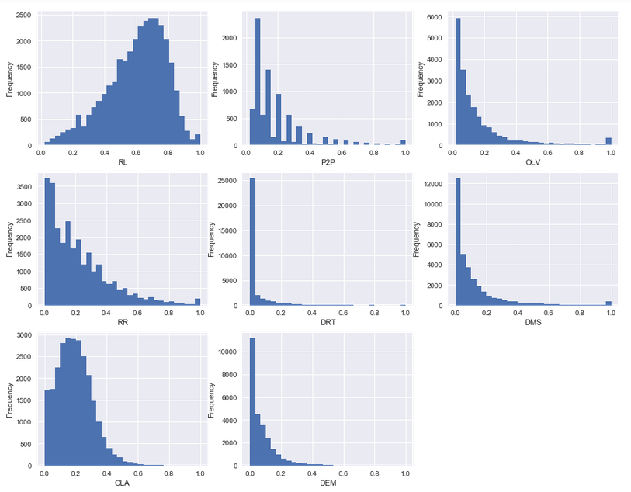
The distributions of the most of the features are highly skewed to the left.
The dataset is biased to lower affinities.

Slide 6
Approach
No strong correlation between any two factors.
So, I dropped the idea of using a linear regressor and switched to a tree based model.
Made pivot tables using Speciality_ID, Value, Gender, Region.
These factors did not explain much variance in the mean values of affinity of the channels individually.
When Region and Value were combined (8 values) there was a better variance in the mean affinity of the channels.
I made use of age to form clusters for certain channels.
I set thresholds on the affinity for channels to see which age groups were predominant but the high percentage of people aged above 100 gave misleading information.

Slide 7
Modified the age column by inspecting the average affinity values and got values from where a difference can be seen.
DEM | Above 65 | Filled with 1
OLA | Less than 65 | Filled with 1
DMS | Above 75 | Filled with 1
OLV | Above 85 | Filled with 1
The above channels would benefit by segregating people on the basis of age as shown above.
I have developed different models for each of the channels since the training set for predicting the affinity varies with respect to channel. (8 training sets)
The remaining channels did not use the age data.
The training and test sets were segregated by separating instances which had Nan for that particular channel into the test data and the remaining into training.
I used a Random Forest Regressor.
‘Channel’ | Speciality_ID | Reg_Value | Age_Segregation (optional) | Gender
I created columns for the values of each of each categorical column. The final training set used by the model contains 26-28 features.

Slide 8
Cross Validation
Need to use the training set for cross validation.
Shuffled the training set and used train test split (67-33) to obtain the validation sets.
Since the sets are designed such that the target variable is the channel and the features do not have missing values, we can use the Random Forest Regressor directly after one hot encoding.
I achieved a score of 0.149 on the model submitted yesterday.

